Slide 1
Introduction to Programming
3. Values, Operators, Expressions and Statements

Slide 2
Java’s Primitive Types
Java has eight “primitive” types
These are used to represent numbers, characters (letters), and true/false values
The names of the primitive types are all Java keywords – note that they are written entirely in lower case
The four primitive types we will use most are
  int, double, char, boolean
The other four are numeric types with different ranges of values
  byte, short, long, float

Slide 3
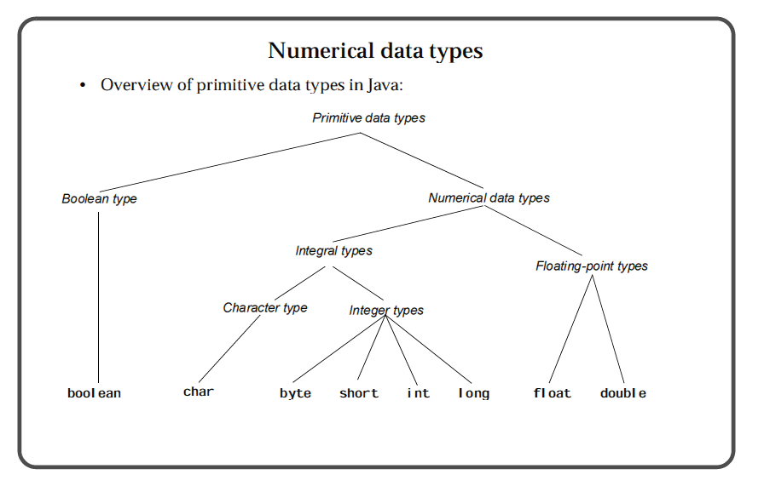
Primitive Types (figure from Mughal, Hamre & Rasmussen)

Slide 4
Numerical Type value ranges
Type | Range of values | Size of values
byte | -128 to 127 (-2⁷ to 2⁷-1) | 8 bits
short | -32768 to 32767 (-2¹⁵ to 2¹⁵-1) | 16 bits
int | -214783648 to 214783647 (-2³¹ to 2³¹-1) | 32 bits
long | -9223372036854775808 to 9223372036854775807 (-2⁶³ to 2⁶³-1) | 64 bits
float | ±3.4028234663852886e+38 (±(2-2⁻²³)×(2¹²⁷)) | 32 bits
double | ±1.7976931348623157e+308 (±(2-2⁻⁵²)×(2¹⁰⁶³)) | 64 bits

Slide 5
Java – Compound Data
Non-primitive data
  Values of primitive types are single atomic values
  Data often has several components:
    A date has a day, month and year
    A name has a surname and forenames, and each one of these is a sequence of letters (chars)
An example of compound data - String
  A String is sequence of characters
  In Java, compound data is represented using a class – String is an example of a Java class
    Note that the class name, String, starts with a capital letter – this is the convention for all Java classes
Notes:
5

Slide 6
Types revisited
A type is a set of values, and a set of operations that can be applied to those values
For the primitive types, and for the type, String, the values can be written directly using literals
  "This is a String literal"
  7.01 // a double literal
  false // a boolean literal

Slide 7
Expressions as values
An expression
  is a construct made up of literals, variables, operators and method calls (where the method call returns a value)
  evaluates to a single value
Examples
  a double expression:
  (d/2.0 + e*Math.sqrt(++a))
  a boolean expression:
  x == 2
  a String expression:
  "Hello " + name
name
is a variable of type String

Slide 8
Operators
An operator is a symbol such as "+", "<=", or "++" that represents an operation that can be applied to one or more values in an expression (quoted from the textbook glossary)
In this module we will look at
  Assignment operators
    Assign a value to a variable ( =,*=,/=,+=,-= )
  Arithmetic operators
    Add, subtract, multiply, divide and remainder operations on primitive numeric values ( +, -, ++, --, *, /, %)
  Relational and equality operators
    Equality: compare values for equality (==, != )
    Relational: compare primitive numeric values ( <, <=, >, >= )
  Logical operators
    AND, OR and NOT operations for boolean values ( &&, ||, ! )

Slide 9
Evaluating expressions
Sometimes, the result of an expression is ambiguous…
  e.g. result = 4 * 1 + 3;
  What gets assigned to result?
    7 or 16?
    depends on the order the operators work in
    Java does multiplication and division before addition and subtraction (so result = 7)
Use brackets to force a different order of evaluation (or simply to make order less ambiguous)
  4 * (1+3) - obviously 16!

Slide 10
Assignment Operator
The "=" operator is used to assign the value on the right hand side of the operator to the variable named on the left hand side of the operator
  The value assigned replaces any previous value the variable had
name = "Albert Einstein";
area = PI*radius*radius;

Slide 11
Assignment continued
Java is strongly typed
  that is, the value on the right hand side of the "=" operator should be the same type as, or a value of a type compatible with, the type of the variable
String name;
name = 7; /* won’t compile, 7
is not a String */

Slide 12
Automatic type conversions
Assignment Operators
  Numeric type compatibility
  A value of any type to the left can be assigned to a variable whose type is to the right (this is called a widening conversion)
  char
  int long float double
  byte short

Slide 13
Widening conversions
For numeric types, can assign a value of a type with a narrower range of values to a variable of a type with a wider range of values
double d = 7; /* OK, int has a
narrower range of values
than double */
int i = 7.0; /* Not OK, double
has a wider range of values
than int (won’t compile) */

Slide 14
Type casts
If you are sure that a variable of a narrower type can hold the value of the wider type (that is, the value is within the range of the narrower type), you can use a type cast to convert the value to the narrower type
int i = (int)7.0; // OK now
We did this in the lab exercise that simulated rolling dice, when we cast the double value obtained by multiplying Math.random() by 6 to an int
(int)(Math.random()*6) + 1
type cast

Slide 15
Automatic type conversions
Arithmetic Operators
  Automatic type conversion occurs
    if the two arguments are of different types (the narrower type value is converted to the wider type value)
    67.0 * 2
    int is converted to double and the result is 134.0 – a value of type double
    if either argument is a short, byte or char (converted to int)
double literal
int literal

Slide 16
Division & Remainder
In this module we are going to use double for real numbers and int for integer numbers so should generally not have to worry about type conversions except for division
  10 / 4 = 2 10 / 4.0 = 2.5
  10.0 / 4 = 2.5 10.0 / 4.0 = 2.5
Remainder operator, %, gives remainder on integer division
  10 % 4 = 2 (as 10 divided by 4 gives 2 remainder 2)
  10 % 3 = 1 (as 10 divided by 3 gives 3 remainder 1)

Slide 17
Increment and Decrement
Java, like C, has ++ and -- operators for numeric values
v++ returns value of v, then adds 1 to v
++v adds 1 to value of v, then returns the value
same for v-- and --v except subtracts 1
int a = 10;
int b = a++; // a equals 11, b equals 10
int c = ++b; // b and c both equal 11
c++; // expression statement (returned value of 11 is discarded), c = 12
int d = --a + b++ + a++; // result: d = 31, a = 11, b = 12
Will follow textbook advice and only use these operators in stand-alone statements, not as expressions

Slide 18
Assignment operators
Java, like C, has variations on the assignment operator that combines arithmetic operators with assignment
v += e; // same as, v = v + e;
v -= e; // same as, v = v – e;
v *= e; // same as, v = v * e;
v /= e; // same as, v = v / e;

Slide 19
Simple Statements
Similar to a sentence in a natural language
Generally each statement is written on a separate line (or perhaps over several lines)
In Java, simple statements end with a semi-colon
  expression statements (that are both a statement and an expression) are also possible in Java
Examples of simple statements
  TextIO.put(d);
  result = (d/2.0 + e*Math.sqrt(++a));
  ++a; // an expression statement

Slide 20
Strings
String is an example of a class
String is included as a standard part of the Java language
String is also a type (e.g. you can declare a variable of type String)
Once a String object is created, it can never be changed
  the jargon is that Strings are immutable
Parallel to “real world” – think of a String as a word or a sentence that you say

Slide 21
Strings continued
A String is a sequence of characters
  Each character is of type char
A literal of type String is written in double quotes
"This is a String literal"
A literal of type char is a single character written in single quotes
'a'

Slide 22
String as a class
One big difference between a class and a primitive type is that a class can define methods
String defines a number of methods that serve as operations on Strings
Once you have a String object you can call its methods to operate on the String

Slide 23
String - some useful methods (see Eck section 2.3.4 for more)
Consider:
  String s1 = "Goodbye";
  String s2 = "bye";
  s1.length()
    This returns the number of characters in s1
    in this case, 7
  s1.charAt(n)
    This returns the char at position n (n is an int)
    The first char is at position 0
    E.g.
    s1.charAt(3) is 'd'

Slide 24
String methods continued
  String s1 = "Goodbye";
  String s2 = "bye";
  s1.indexOf(s2)
    This returns the index position in s1 of the first occurrence of the String s2
    in this case, it returns 4 as the String “bye” can be found as a substring beginning at position 4 of “Goodbye”
  s1.toUpperCase() returns "GOODBYE"
  s1.toLowerCase() returns "goodbye"
    Important! These methods return a new String.
    The original String is not changed, it is still "Goodbye"
    Can make s1 refer to the new String by writing, for example:
    s1 = s1.toUpperCase();

Slide 25
Data Structures
Most pieces of information that we use are part of something bigger
  A single name could be one entry in a register of names
  A date of birth is just a date, but is also part of the information about a person
Programming languages provide structures to collect data together
  Arrays, Lists – collections of data of the same type (like the register)
  Records – a collection of data of different types (like the info on a person)
    in Java a class is used to group the fields of the record
list = new int[10];
Index
Value
0
81
1
23020
2
-1702
3
1200
4
185
5
-17402
6
31048
7
100
8
17
9
64
class Student {
String name;
int mark;
}
name
Fred Smith
mark
55

Slide 26
Java and Objects
Arrays and “records” in Java are instances of classes, or objects
Unlike for primitive types a variable of the type contains a reference to the object and NOT a value of the type
Instances need to be created using a constructor (more on this later)
  Student currentStudent = new Student();
  currentStudent.name = "Fred Smith";

Slide 27
Structured Programming
Apply structure to data (information) to simplify organisation
  Arrays and records (Java classes) keep pieces of data together to maintain the associations in real life – a name, address and phone number, a list of web addresses
(Next week we will begin to) use structure in executable statements to make the execution adapt to the prevailing circumstances
  Process data according to conditions
  Process a lot of data using only a few statements

Slide 28
In this lecture….
Expressions and Statements
  Expressions compute a value
  Statements as instructions, end in a semi-colon
The eight primitive types
  boolean, char, int, double, float, byte, short, long
String – an example class
  String is a type, strings are immutable

Slide 29
In this lecture….
Compound data
  Data that has more than one component
Data structures
  “Records” and arrays
  In Java these are classes

Slide 30
Reading for Next Week
Continue reading chapter 2 of Eck
  sections 2.3, 2.4 and 2.5
Next week we will start to look at control structures
Notes:
30

Slide 31
End
Questions?

